Slide 1
zomato
Project Presentation
by Yash Kumar

Slide 2

A flavorful adventure with Zomato
Like a well-seasoned recipe, Zomato has blended technology and taste to curate a delightful experience for tech & especially food enthusiasts across the Nation and beyond.

Slide 3
A Glimpse before Diving in
Zomato, launched in 2008, has evolved from a simple restaurant listing platform to a global food powerhouse. With operations in over 15 countries, it connects millions of users with diverse restaurants, offering services like online ordering, delivery, table reservations, and even grocery delivery. Think of it as a universal guide and connector for all things food, navigating users through a vast culinary landscape while helping restaurants reach new audiences. As they embark on ambitious global expansion plans, understanding user preferences, local trends, and navigating the competitive landscape will be key.

Slide 4

Problem Statement
You are hired as a consultant data analyst by zomato where the team is looking for expansion and opening restaurants.
Your task is to come up with strategies/suggestions about opening newer restaurants.

Slide 5

Let’s dive into the data feast!
Zomato’s dataset of restaurants and foods is deliciously vast.
My Excel sheet Zomato_Analysis serve as the backstage pass, unveiling the intricate flavors and trends discussed in this presentation.
Hungry ? Your data and it’s analysis has been prepared.
So let’s just get into it!

Slide 6
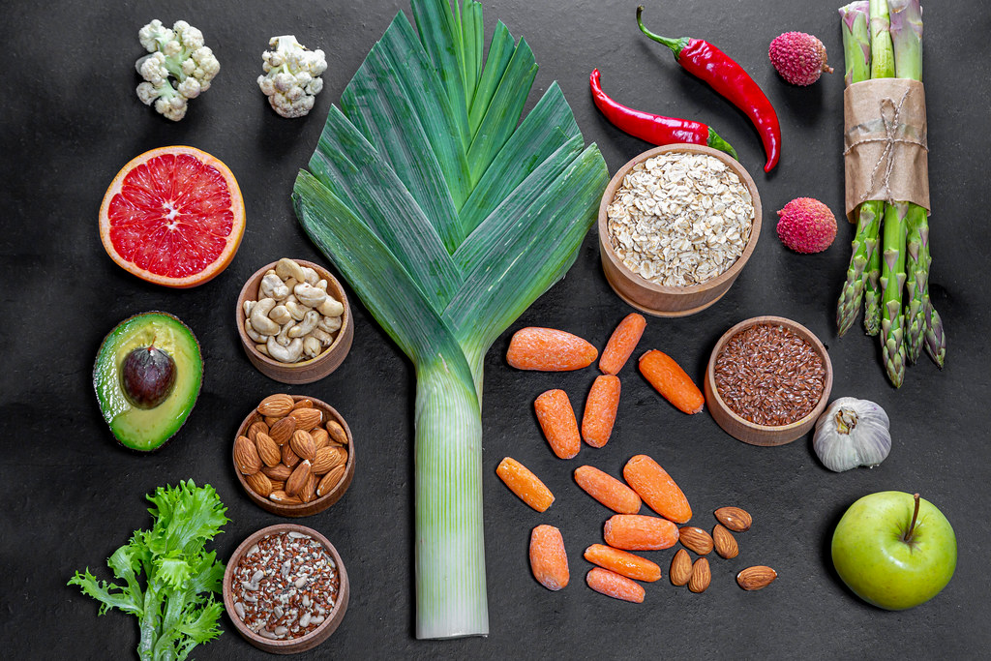
Raw to Ready
Okay so what do we do when we wanna make a dish ?
We get the raw vegetables/items that we clean, cut & organise stuffs, isn’t it ?
Similarly, we have cleaned and organized our raw dataset for better readability, operations & analysis.
And now we are ready to cook…

Slide 7
What did we do ?
Fixed the inconsistent values DateKey format & City Names
Filled missing values Filled with ‘No Data’ in Cuisine section
Generated new/hidden data Generated Year, Month from DateKey column, Converted costs in Rupees with creation of separate CoversionTable sheet, Split Primary Cuisine from all Cuisines
Moved and Organised data Moved & Grouped columns accordingly to make data more readable and get necessary information in one page.

Slide 8
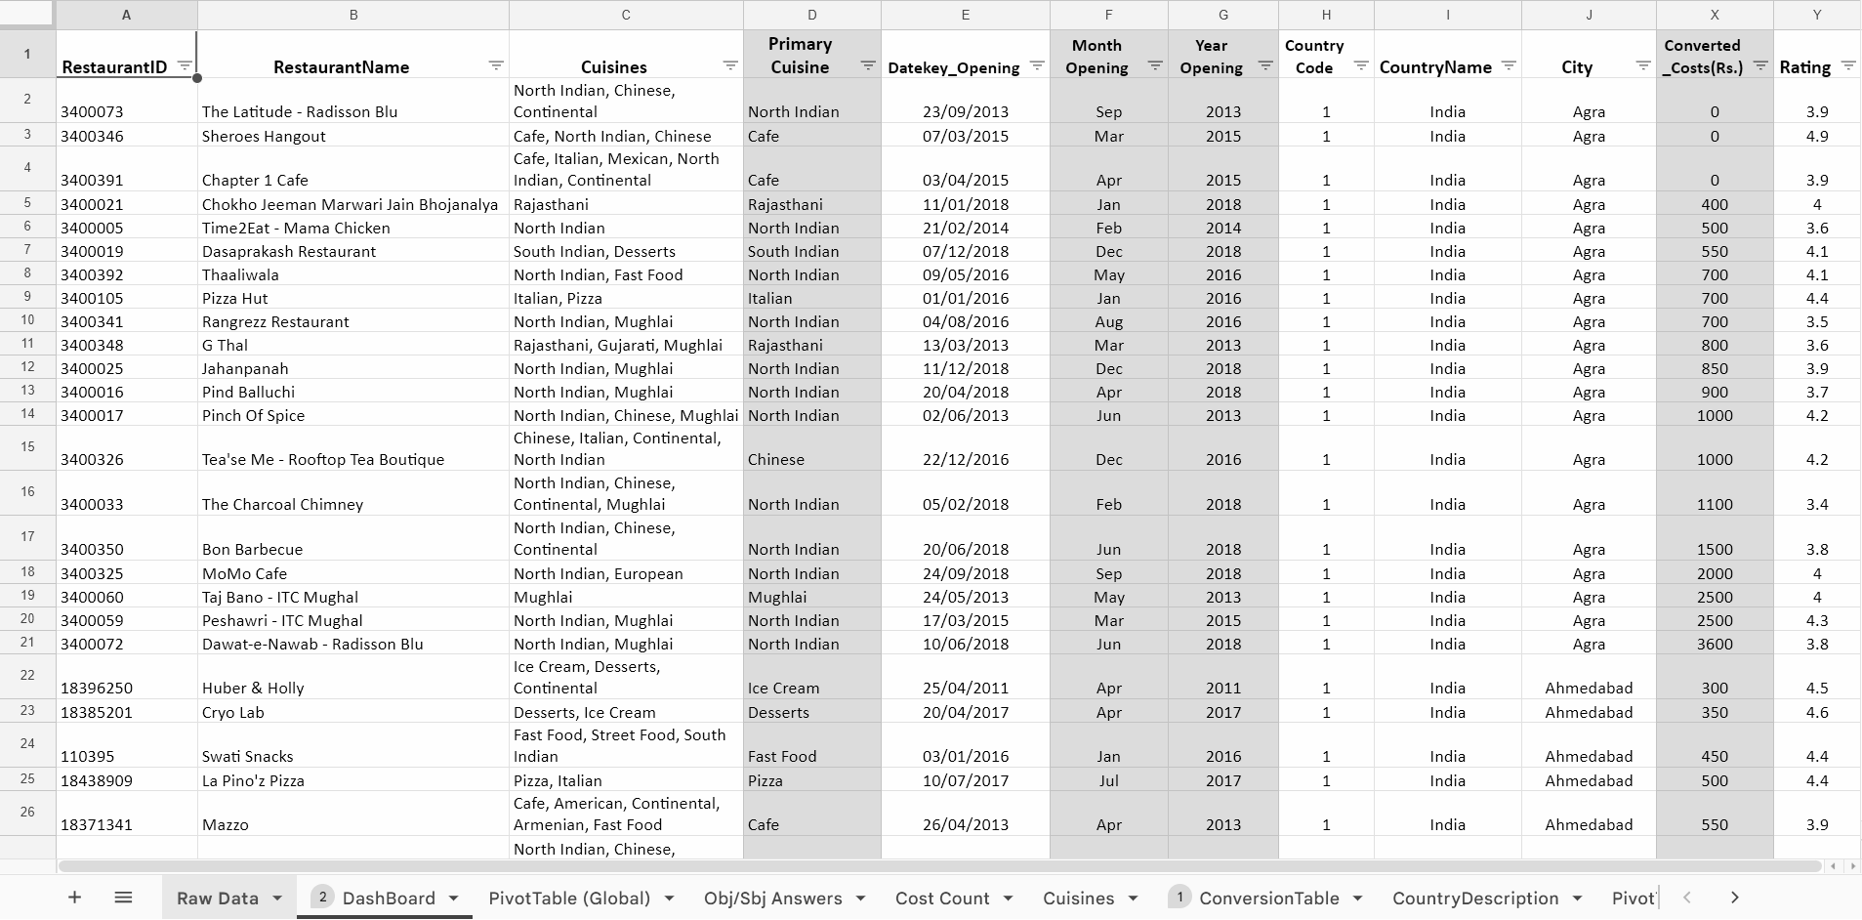

Slide 9

Cook by the Book
What do we do now ? We Cook!
Created pivot tables Created multiple pivot tables to get diverse insights. Two main pivot tables: Global & Indian.
Created visualization charts Created suitable visualization charts from those pivot tables.
By the book Created pivot tables and suitable charts as asked for
objective & subjective problems in document, with proper formatting.

Slide 10
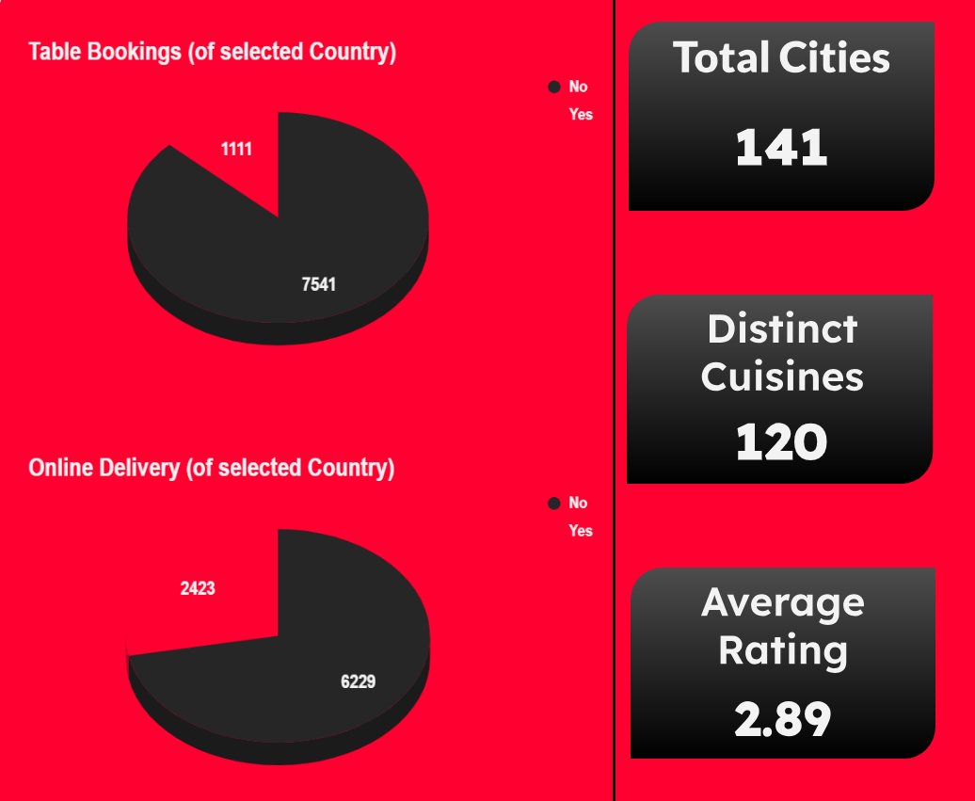
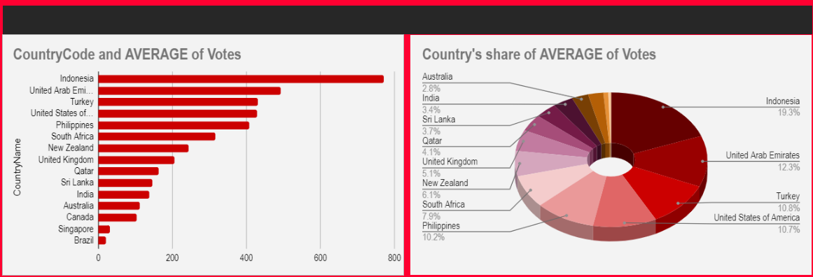
We have some main global data like total cities, cuisines & rating.
Indonesia has highest amount (19%) of average active voters share.

Slide 11
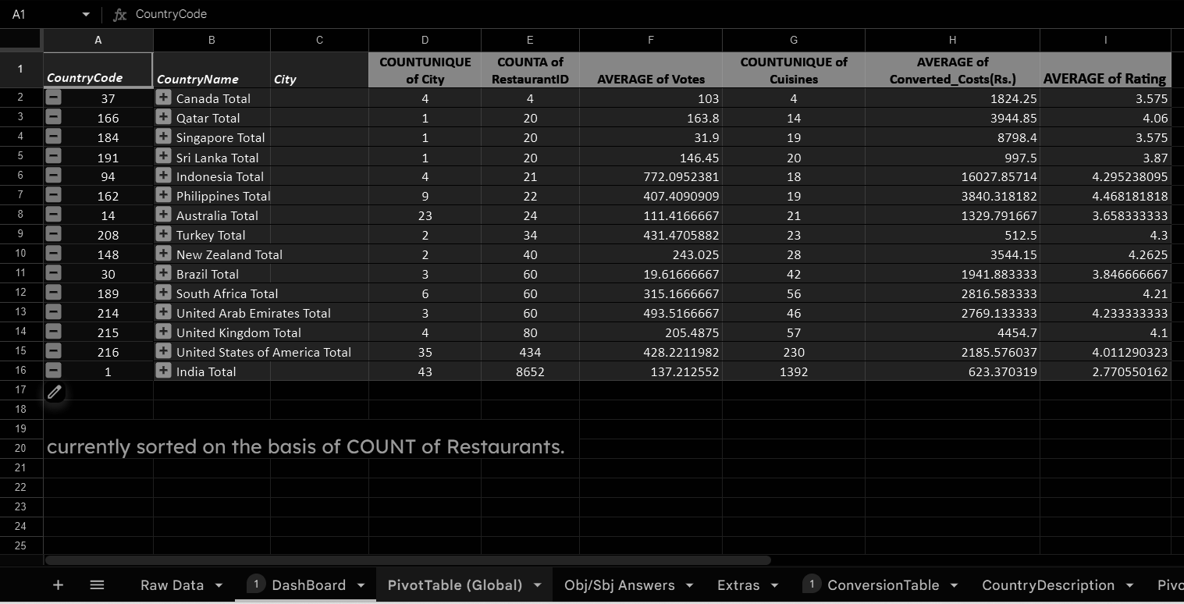
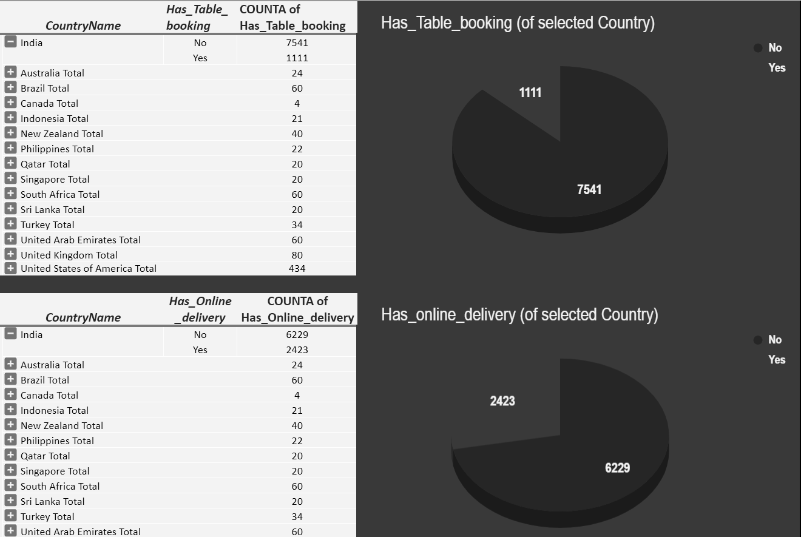
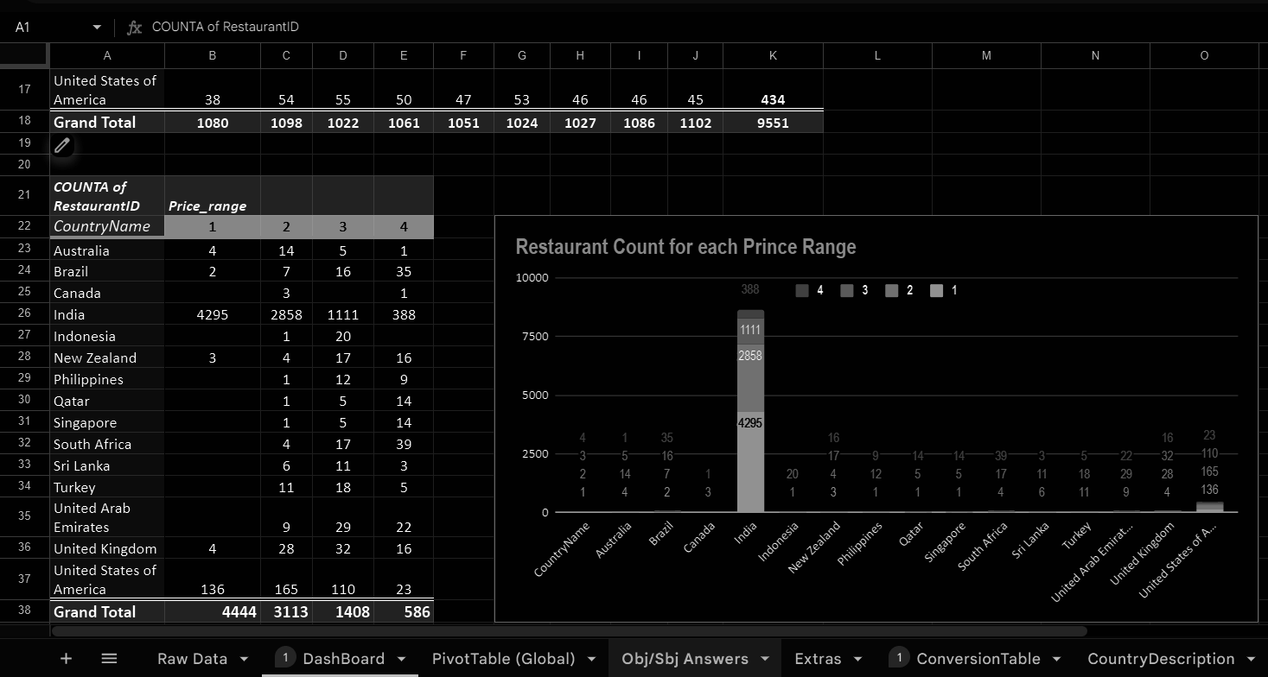
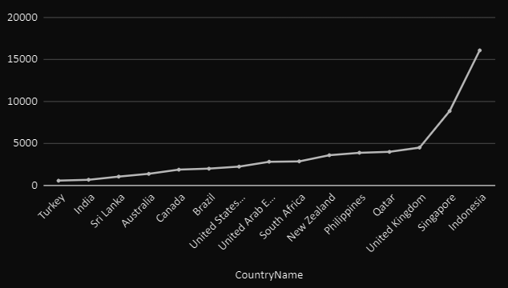
All pivot tables and charts can be accessed in sheet. and also they are colorful :)

Slide 12

Dressing the Dish
It is finally the time when you dress up the dish and present to customer.
It’s the live Summary of the dataset in more visualising way for getting the gist of our data.
Created Dashboard
Presented the summarised information in organised manner.
Made it Interactive using pivot tables.
Formatted for better readability & understanding.
Formatted while keeping theme of project intact and appealing.

Slide 13
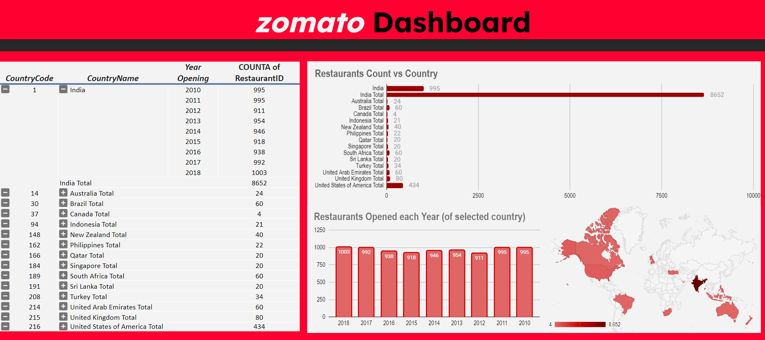
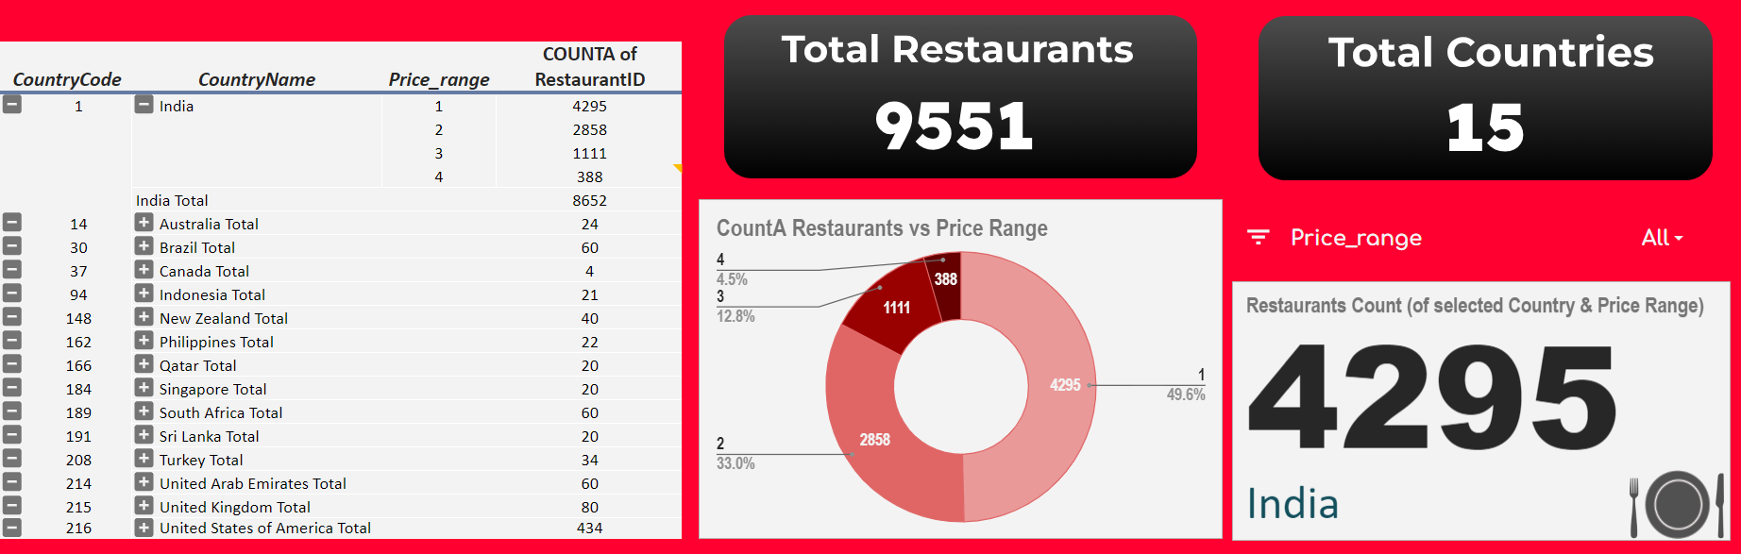
Dashboard is Interactive using pivot tables.
There’s more of it in sheet.
So that you don’t miss out on neither any data info nor your food.

Slide 14

Statistical Insights
Total Restaurants worldwide: 9551
Total Countries Service: 15
Total Cities Service: 141
Distinct Cuisines: 120
Global Average Rating: 2.89

Slide 15
Key Insights
All Currency values are in Indian Rupees (INR)
Country with most restaurants: India India has total of 8652 restaurants that takes 48% of total portion globally.
Country with most no. of voters: Indonesia
Indonesia’s average votes is 772 which makes up 19% of total portion globally.
Country with highest rating: Philippines Rating: 4.47
Country with lowest rating: India Rating: 2.77
Highly Expensive countries: Indonesia & Singapore
Average Cost of two in Indonesia: > 16K, Singapore: > 8K, Others: < 4K
Most Affordable countries: India & Turkey
Average Cost of two in India: < 700, Turkey: < 600, Others: > 1K

Slide 16
Written Wrap Up
It’s better to have the analysis well documented in word as well for quick & specific query from whole dataset.
Created the Doc file Word file with all the Objective & Subjective problems and its suitable answers with proper formatting.
My doc file: Zomato_Analysis

Slide 17
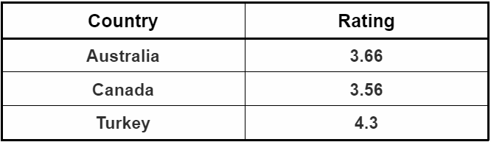
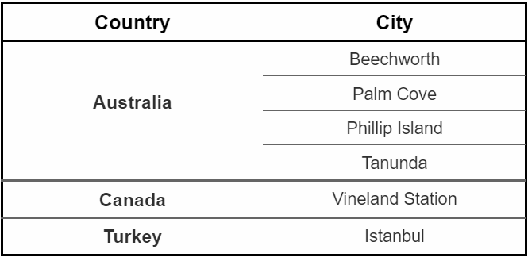
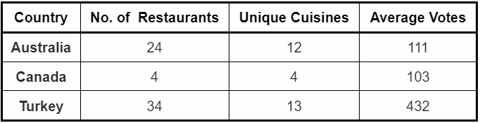
Conclusion & Suggestion
Promising countries to open new Restaurants:
Australia
Canada
Turkey
Why ?
In short, better rating, fewer restaurants, enthusiastic food people in reasonable range of price.
Detailed stats can be viewed in doc.

Slide 18
Learning & Improvement
Not every time you make a dish is perfect, especially not the first. You learn along the way & keep getting better.
Concepts learned
Learned the working in excel & advance excel
Proficiency in using formulas, pivot tables, charts in various conditions.
Operation & formatting on raw dataset from scratch.
Analytical thinking for creating meaningful Insights from data.
Creating interactive Dashboards.
Summarizing and writing up insights from data.
Documentation and presentation of work done on analysis of data.
Areas for Improvement
Dashboard: Still don’t understand why some shapes gets misplaced automatically.
Presentation: Takes a good long time thinking of presentation, its theme & formatting, that it gets delayed in execution and becomes hassel.

Slide 19
pasta la vista
Hopefully you enjoyed analysis as much as I worked making it.
Quick Tip If you get bored or stuck in analyzing Zomato dataset, quickly order something from Zomato. Surely works :)

Slide 20
thank you

